Slide 1
Unlocking the Power of Pointers in C
Presented By: Chitra Jitendra Shinde
Kartikeya Rindani Intercollegiate Seminar Competition 2025

Slide 2
Agenda
Introduction
Understanding Pointers
Basic Programs
Advanced Concepts
Final tips & takeaways

Slide 3
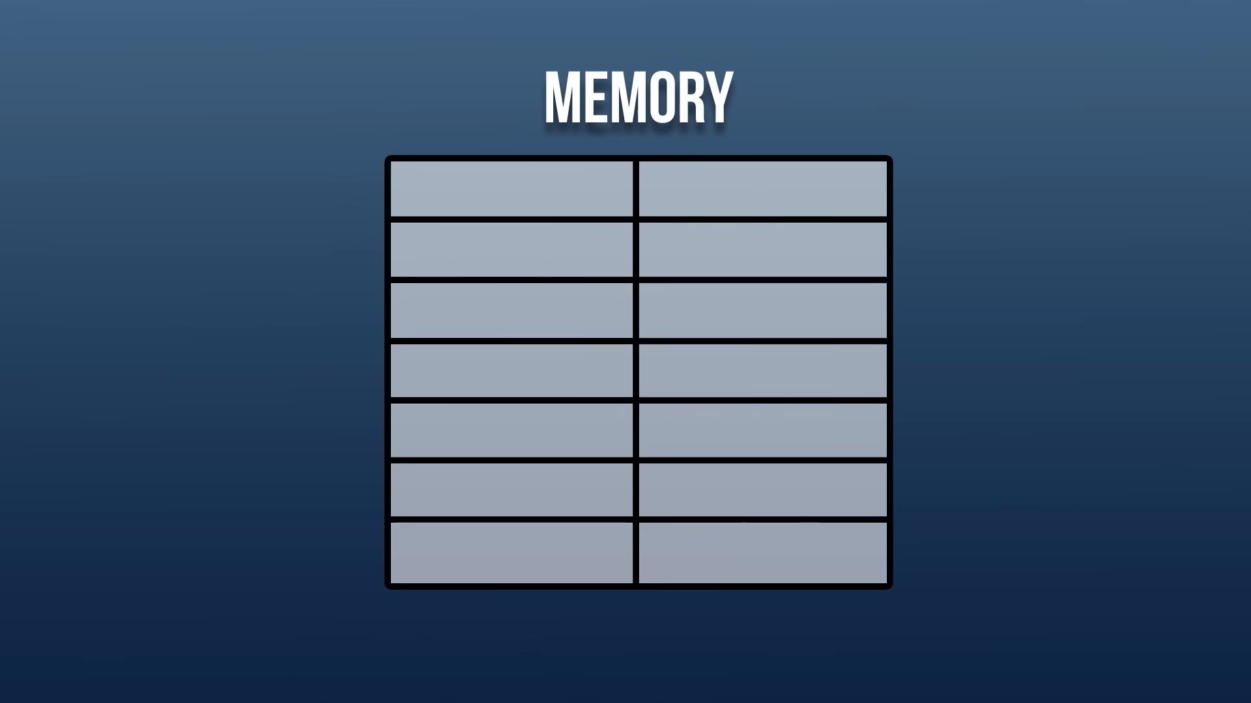

Slide 4
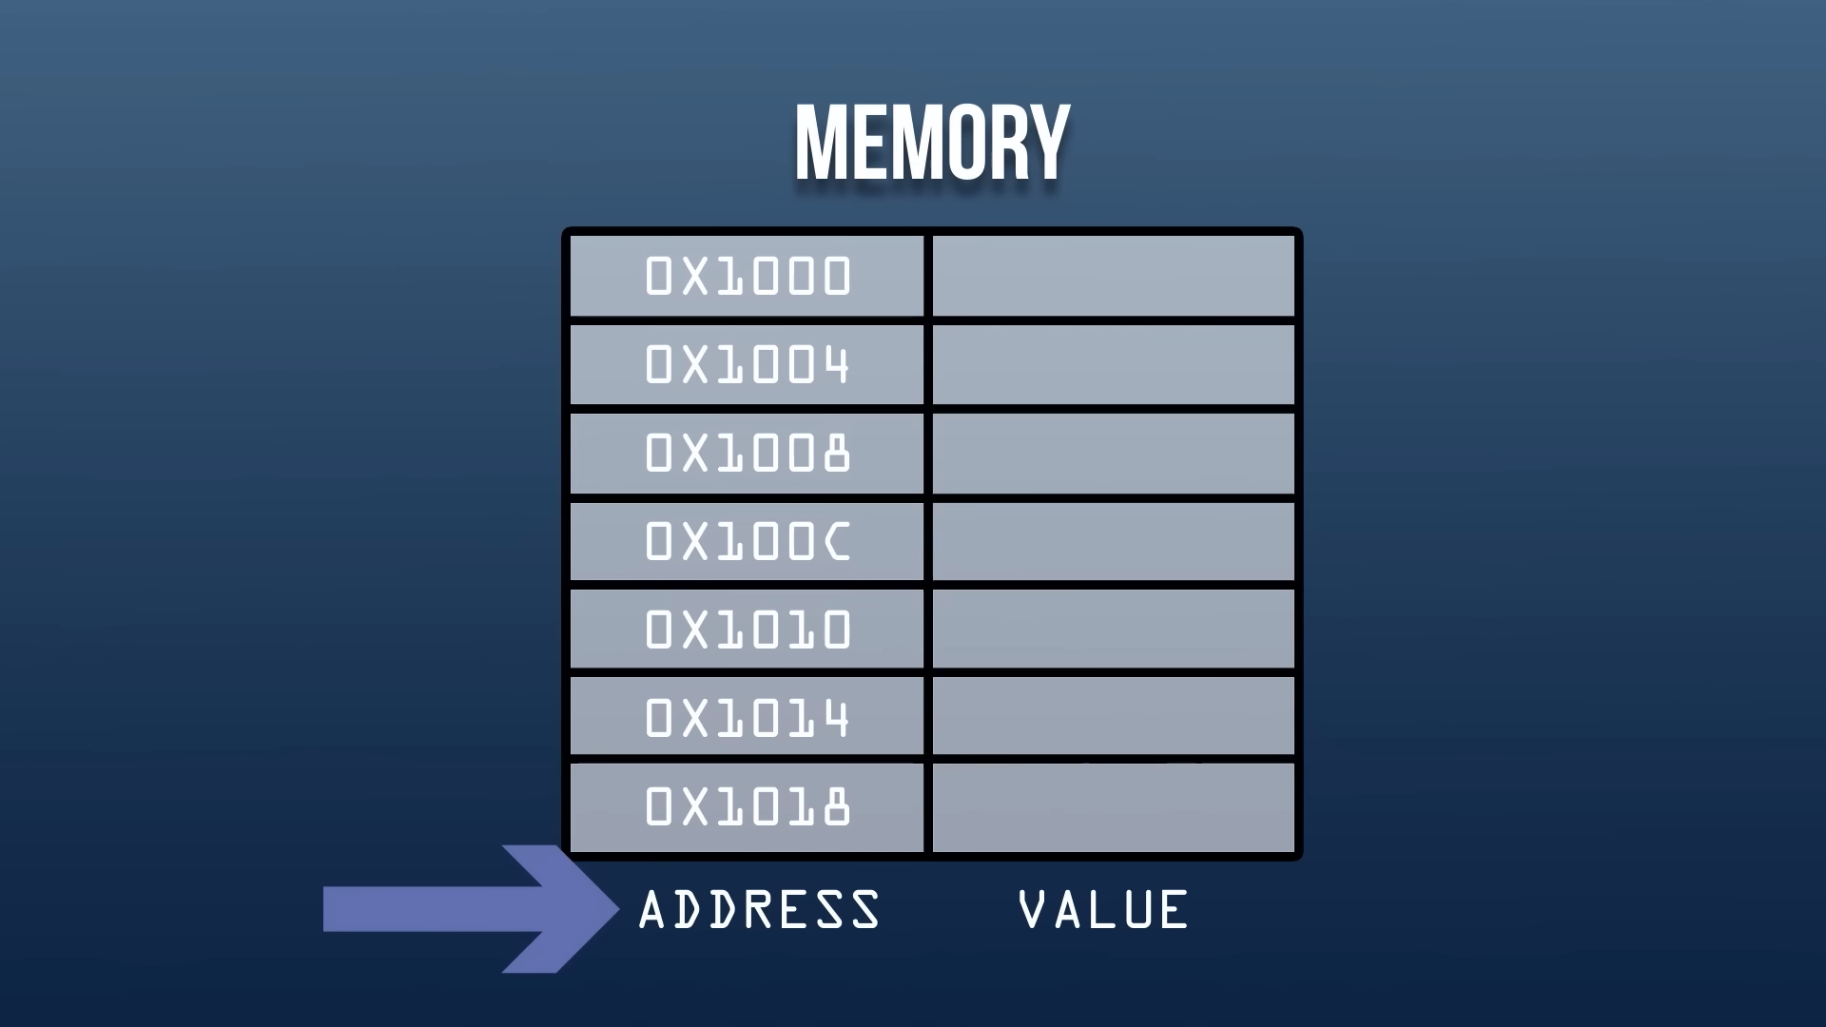

Slide 5
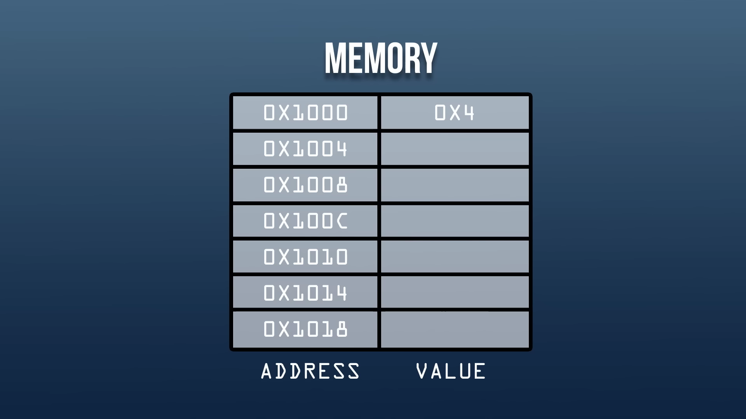

Slide 6
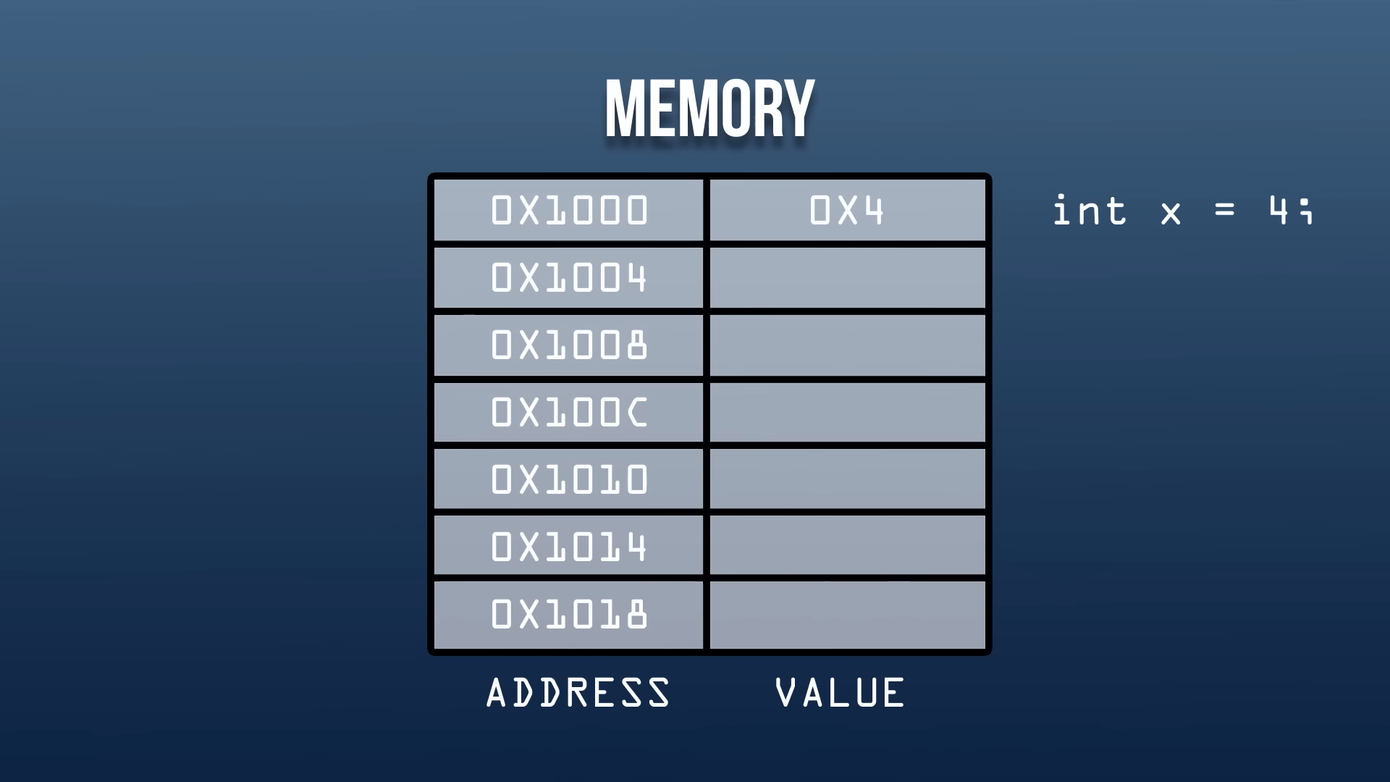

Slide 7
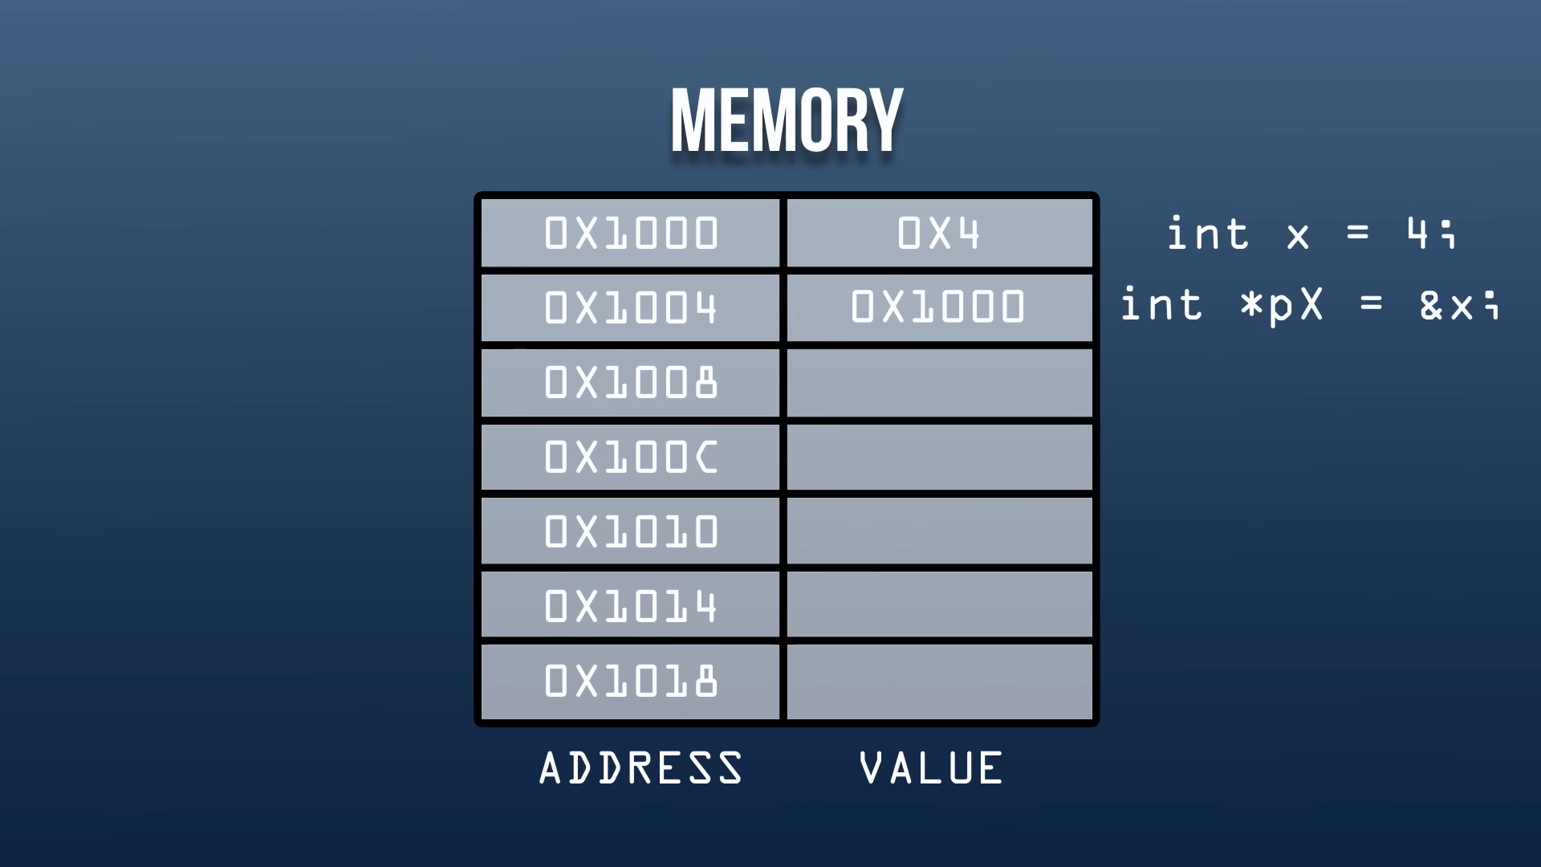

Slide 8
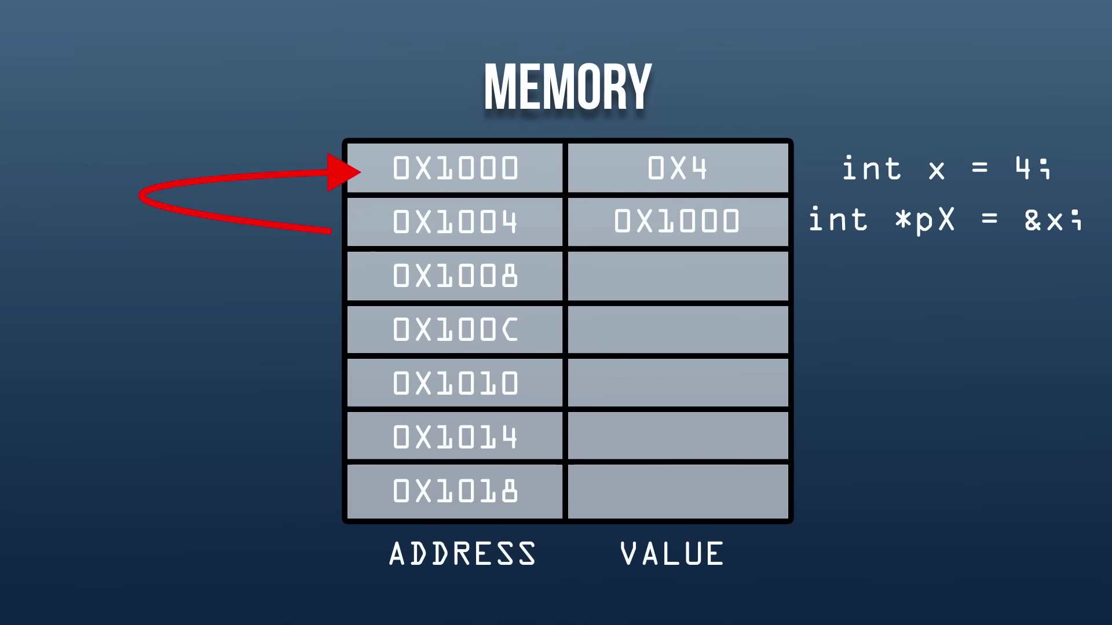

Slide 9
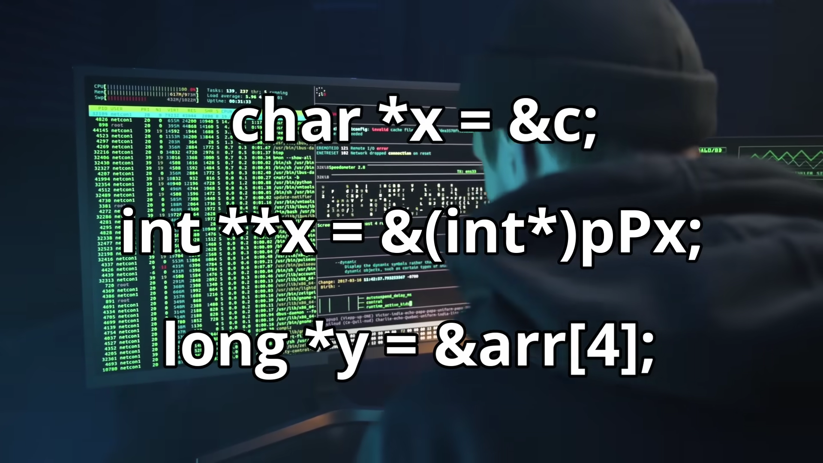

Slide 10
int x = 10;
English : “Integer Named X Is Set To 10”

Slide 11
int *px = &x;
English : “Integer Pointer Named pX Is Set to the Address of X”

Slide 12
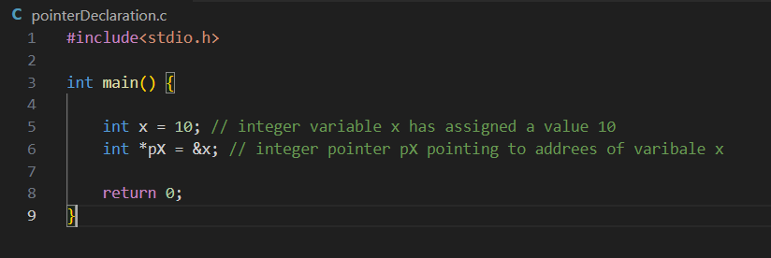
Pointer Declaration in C

Slide 13
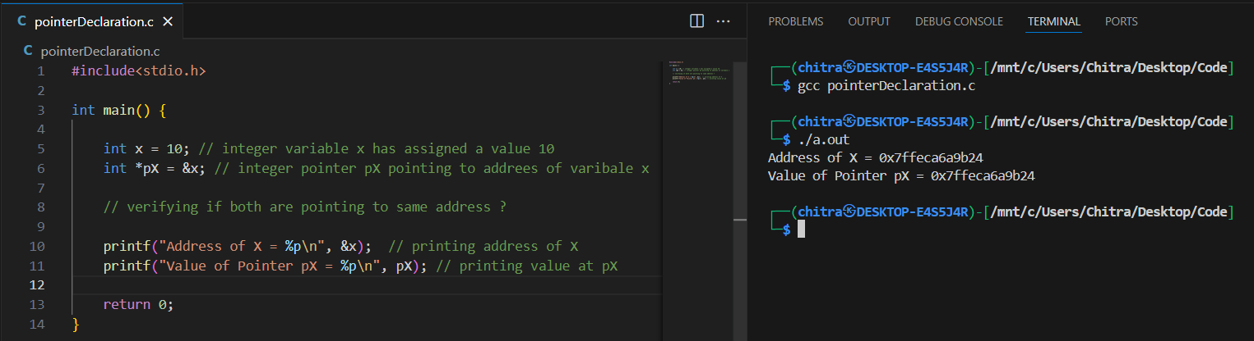
Verifying Declaration

Slide 14
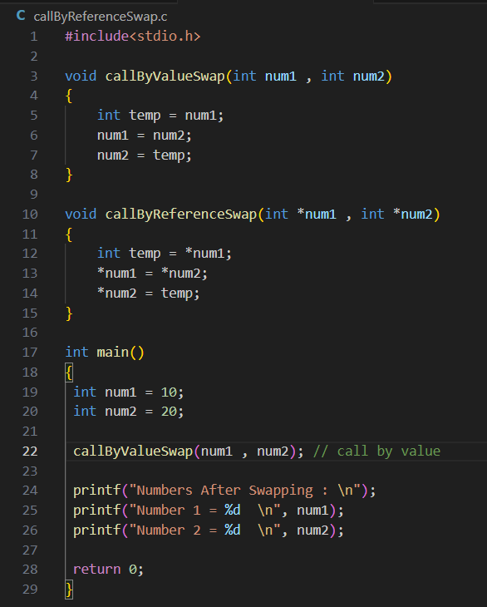
Swapping 2 Numbers

Slide 15
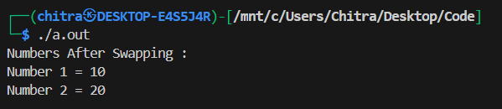
Swapping 2 Numbers

Slide 16
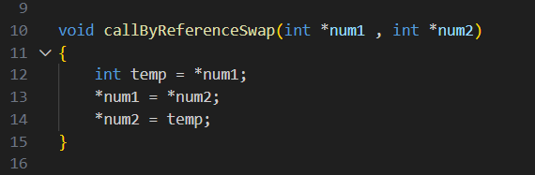
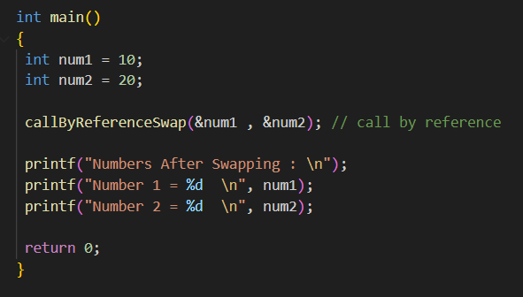
Swapping 2 Numbers

Slide 17
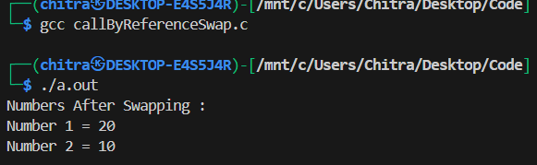
Swapping 2 Numbers

Slide 18
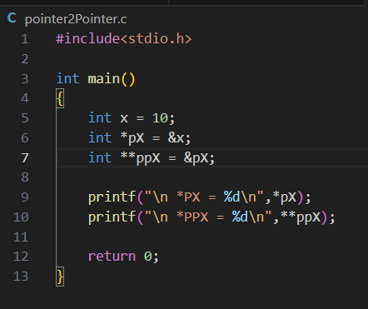
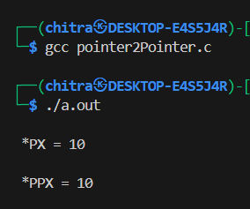
Pointer 2 Pointer

Slide 19
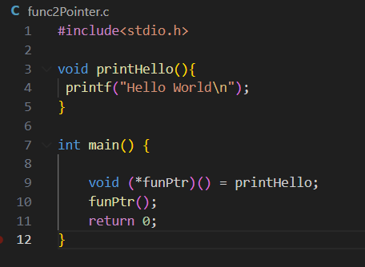
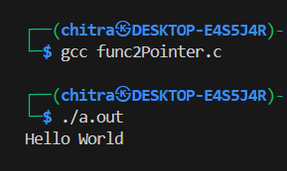
Function Pointers

Slide 20
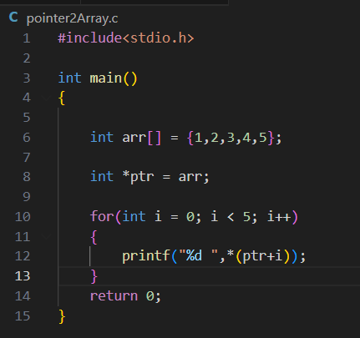
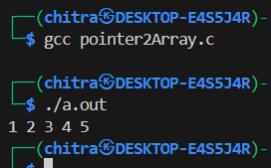
Pointer to an Array

Slide 21
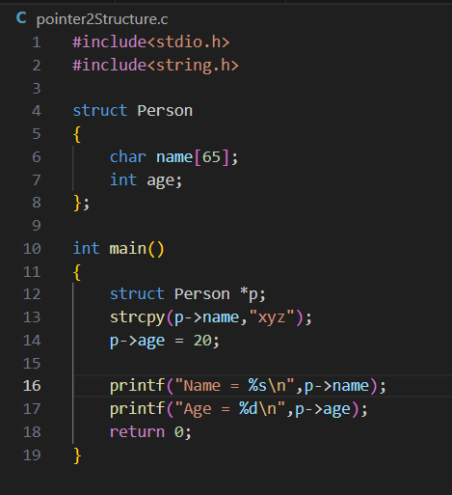
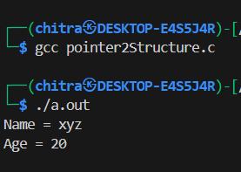
Pointer to a Structure

Slide 22
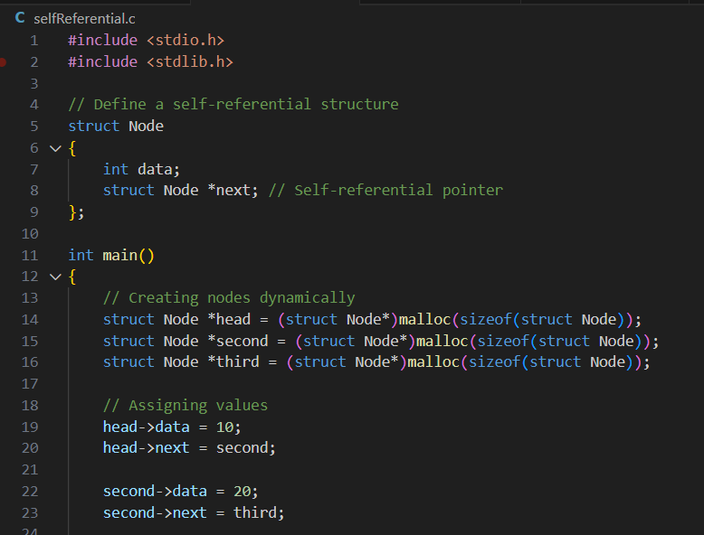
Self Referential Pointer

Slide 23
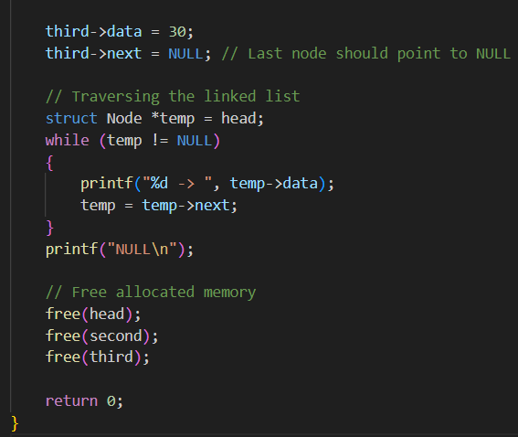
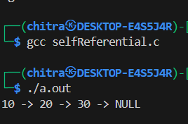
Self Referential Pointer

Slide 24
Real-World Applications of Pointers
✅ Operating Systems (Memory Management)
✅ Embedded Systems (Microcontrollers)
✅ Game Development (Optimization)

Slide 25
Common Mistakes and Security Issues
🚨 Dangling Pointers
🚨 NULL Pointer Dereferencing
🚨 Memory Leaks
Example:
int *p = malloc(sizeof(int));
free(p); p = null;

Slide 26
💡 Final Takeaway:
Pointers are powerful but dangerous if misused. Just remember: ✔ Always free memory when done. ✔ Always set pointers to NULL after freeing. ✔ Always check if a pointer is NULL before accessing.

Slide 27

Linking You to the Code, Just Like a Pointer!
📂 What's Inside?
✅ PowerPoint Presentation - Well-structured slides with code snippets 📊 ✅ Code Examples - Practical implementations of pointers 🧑‍💻 ✅ K&R Book PDF - The legendary book "The C Programming Language" 📖

Slide 28

Thank You
Linkedin : https://www.linkedin.com/shinde-chitra

